Slide 1
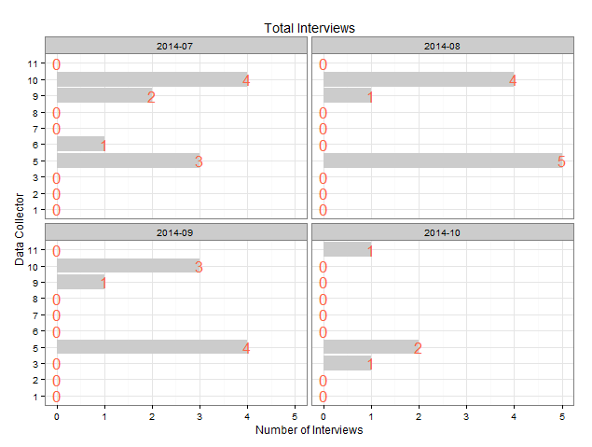
Example Report (4 Week History)

